Slide 1
Informatics Theme
Kassy Raymond, Dr. Deborah Stacey and Dr. Theresa Bernardo
kraymond@uoguelph.ca

Slide 2
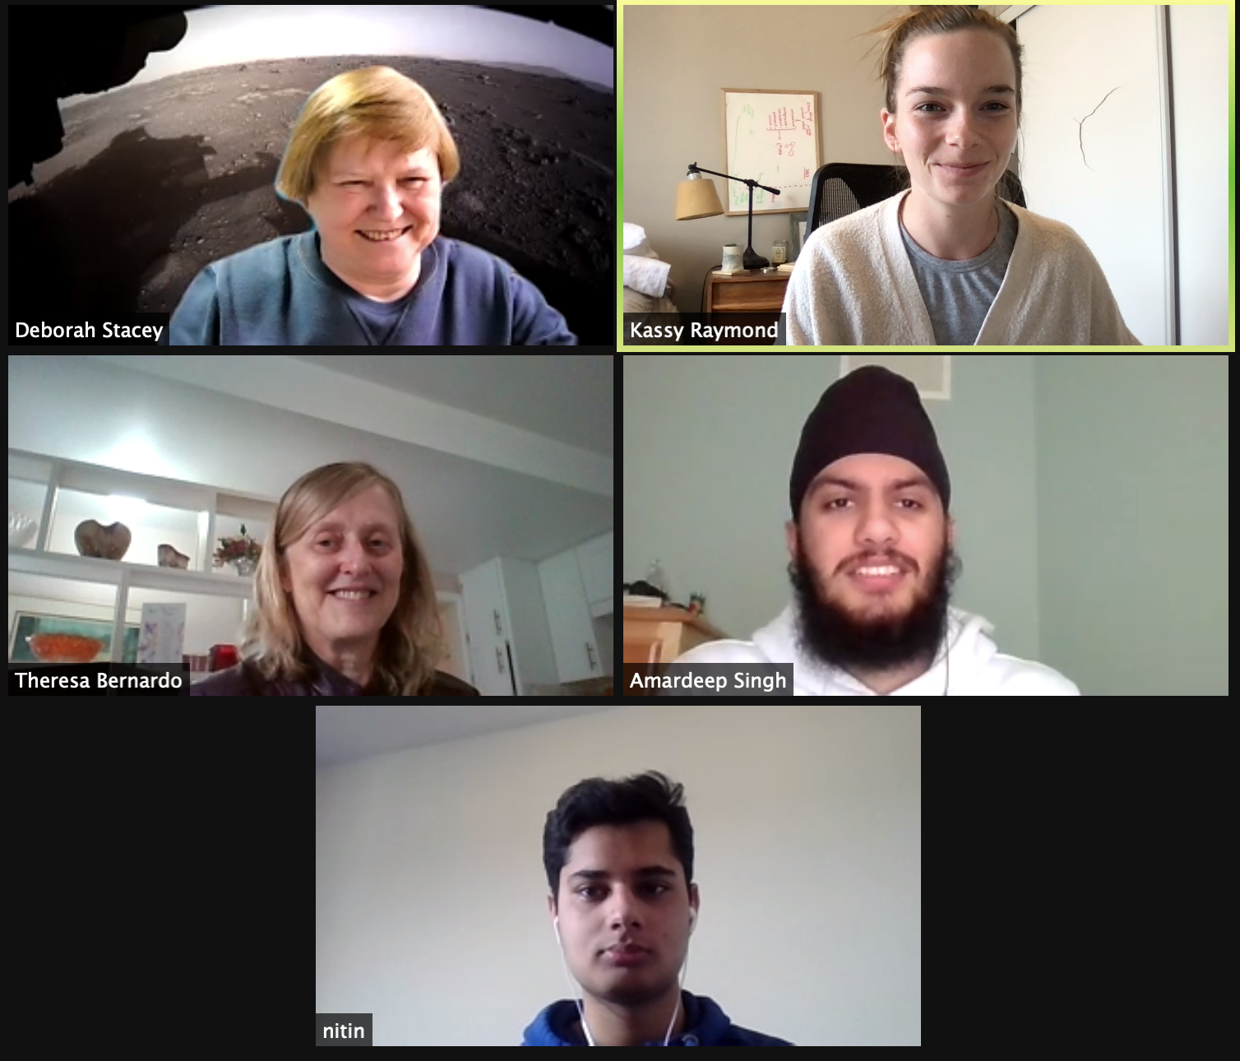
Our Current Team
Notes:
Introduce our team using zoom group photo

Slide 3
Overview:
Knowledge Engine (KE)
What it is
How it works
Data distribution
KE development framework
Data discovery and curation
Data management
Privacy and security
Applications to Aquaculture

Slide 4
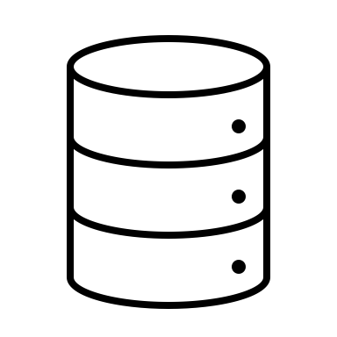
GBADs Data Knowledge Engine (KE):
Creation of a metadata-driven knowledge engine (KE) that brings together relevant data from many different sources
Relevant Data
World Bank
OIE WAHIS
FAOSTAT
GBADS data portal
Model Output
Notes:
Introduction to the knowledge engine. Give broad idea of what we are trying to do – provide access to data from many different sources through the GBADs portal. Enable querying and data download from the engine. Eventually use metadata to understand where data are rich and poor, who the ket stakeholders are and how data have changed over a temporal scale (just a few examples).

Slide 5
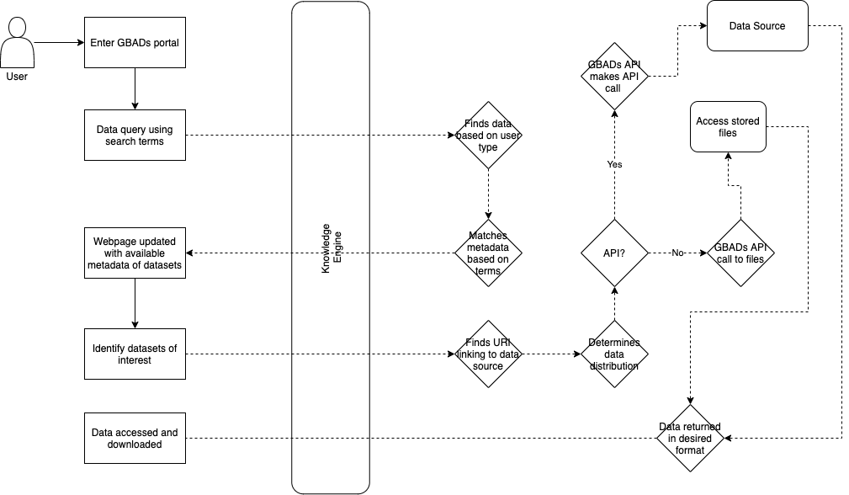
How it works:
Notes:
So what does this actually look like?
Unregistered user comes in and then bring them through the flow chart.

Slide 6
Notes:
So what does this actually look like?
Unregistered user comes in and then bring them through the flow chart.

Slide 7
3 ways to access data:
Direct download
Navigate to website and download data in an available format (usually csv)
Application Programming Interface (API)
Machine to machine communication
Ask for specific data from your machine → your machine asks a server for data → server returns data of interest
Do not need to store data
Scraping web or documents
Programmatically convert data tables from PDF documents or webpages to a more accessible format (csv)
Difficulty dependent on complexity of table or website
Notes:
Tell everyone what an API is
Other ways to get data
3 ways to access data
scraping web or documents

Slide 8
KE development framework
Data discovery and curation: Profiling data and tracing data lineage (provenance) and determine vocabularies, ontologies, classification systems and codes used in the data domain
Data management: Create standard metadata (DCMI and schema.org), catalogue metadata
Policies, privacy, security and access: Understand data privacy issues, data politics, access constraints and licensing
Ingest metadata into graph database
Notes:
So how do you operationalize this idea of data governance to create something like a knowledge engine?

Slide 9
1. Data discovery and curation
Talk to domain experts about data needs, usage and requirements
Curate list of data sources
Open, private, government
Understand the key focus areas
Understand how data are represented (vocabularies, ontologies, codification)
Determine how to access data
Direct download (csv, API, webscraping)
Notes:
1. Data discovery and curation
detrmine how to access data

Slide 10
Metadata Creation
FAIR(S) metadata
Findable, Accessible, Interoperable, Reusable and Secure
Use of standards for metadata terms and properties
DCMI, AGROVOC, schema.org, geonames
Descriptive metadata integral for findability, interoperability and reusability of resource (discovery and identification)
Title, subject, abstract, author, keywords, grant agencies etc.
Technical and access metadata to govern accessibility and security
Licensing, size, distribution, privacy, accessibility
Notes:
exxamples for each

Slide 11
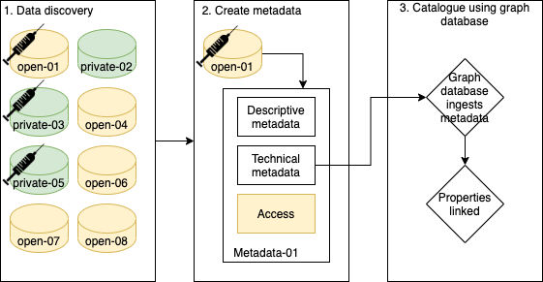
Metadata, privacy and KE
Notes:
Overview of how metadata informs system
Needle = vaccination data
Say an unregistered user queries for vaccine data - Unregistered user only has access to open-01
Special privileges – queries for vaccine and is given 01, 03, 05 and 08

Slide 12
KE and Aquaculture
Using salmon production as a pilot, collect all relevant sources of data
Establish key issues/modelling use cases (diseases such as sea lice, ISA, PD)
Collaborate with other teams and modelers to see what data they are using (already started)
Determine unique disease information about aquaculture and language used to describe it in order to create rich and findable descriptive metadata
Contact OIE to access disease data
Data discovery and metadata creation can happen simultaneously if descriptive metadata standards are established (domain specific knowledge required)

Slide 13
Preliminary Data Sources
Open sources:
BarentsWatch (Norway)
FishStat (FAO)
StatsCanada
Norwegian Directorate of Fisheries: Statistics for aquaculture
Literature can inform where to find data and provide data of interest (which can be scrapped)
Norway = data rich
Chile = difficult to get data

Slide 14
Questions

