Slide 1
GBADs Executive Committee Meeting: Informatics Updates
Dr. Theresa Bernardo, Dr. Deb Stacey, Kassy Raymond, Dr. Grace Patterson, Dr. Neila Ben Sassi
dastacey@gbadske.org

Slide 2
Agenda
Framing the Roadmap to Reproducibility
Dashboard development cycle – where we are now
Connections, meetings and affiliations
The specifics: API and dashboard development

Slide 3
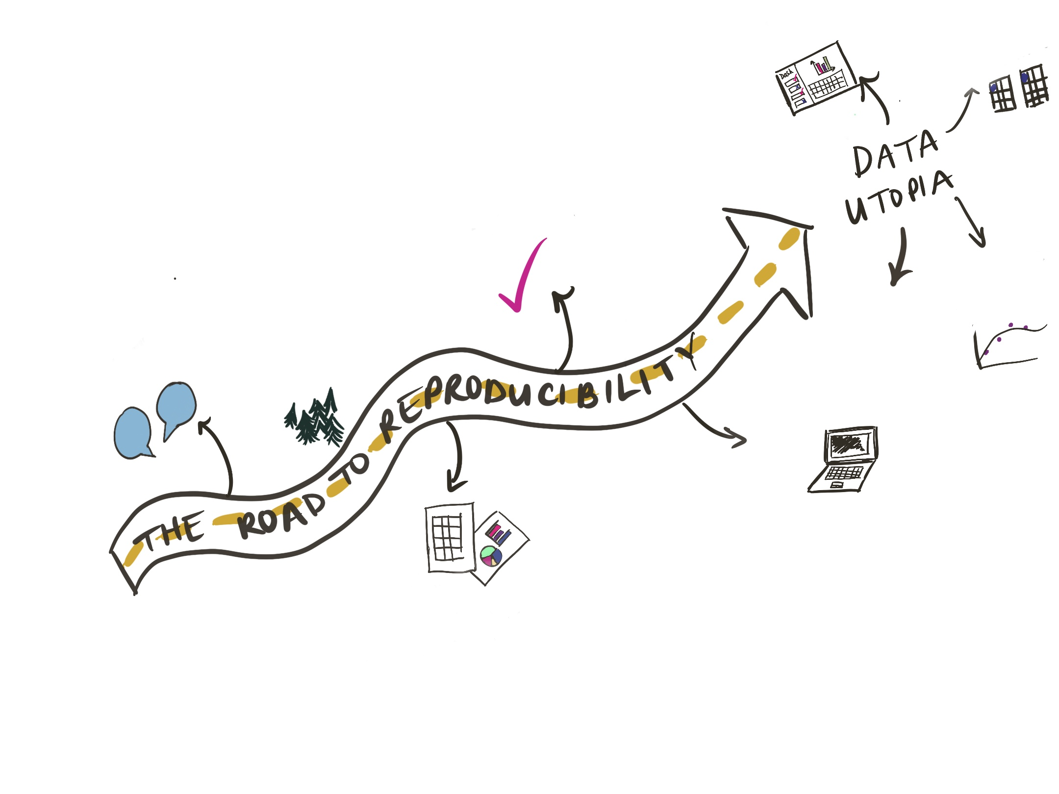
1. The Roadmap to Reproducibility
Data harmonization
Dashboards
High quality models
Data quality
Informed decisions
People and processes
Acquisition and ingestion of data
Code
Notes:
So, as we talked about in September, we like to draw back to the overall theme of research reproducibility as pertains to data
We created the analogy "the road to reproducibility", where the stops along the way allow us to standardize, streamline and communicate our data methods and research in a manner that is reproducible.
These last few months we have focused specifically on honing our code for reuse, making dashboard developments more streamline through iterative code production and taking a closer look at data quality through comparing categorizations of data semantics and how this relates to interoperability. We have also made developments in the data catalogue and metadata. We can’t cover all of this today, so we will stick with the most relevant things, which include an overview of the dashboard development cycle, give you an update on our ongoing collaborations and then Deb will talk about the specifics of data tables in the cloud, dashboard developments and our launched API. Ultimately, we are still working towards the goal of everyone in GBADs using the same data in all modelling and analytical efforts, so we can track and streamline data processes as our efforts continue to grow.

Slide 4
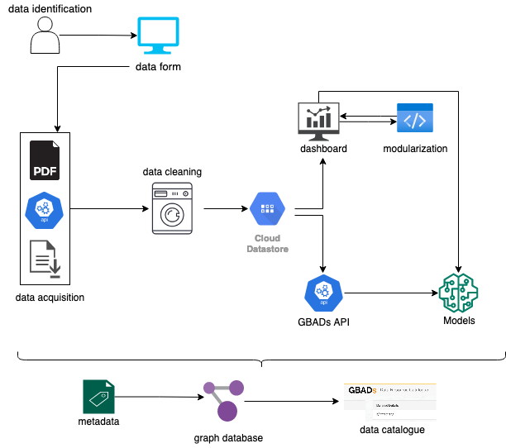
Notes:
* Note that I will be flowing through the diagram with my cursor!
Here we have the overview of our dashboard development cycle, which we have working on as we continue to streamline processes, develop more code and analytical procedures and clean, assess and analyze more data.
As always we started with data identification. we have soft launched our data acquisition form which is undergoing testing from other members of GBADs.
Once we have acquired the data source, we look at ingesting it. We again note the 3 ways that you can get data including scraping from PDFs, APIs and direct download. To date all of the Ethiopian data from the CSA reports have been scraped and cleaned.
We then go to data cleaning which includes internal and external data quality, as we discussed in the September meeting. More recently we have been looking at the notion of semantic interoperability, which we define as “the ability to capture and combine the contextual and linguistic meaning of terms or ideas so that they can be applied to communicate between processes, themes, programs, and data”. This includes looking at how the categories of data differ between and within data sources.
Following cleaning, when applicable, we store data in the AWS cloud in databases that are designed by students. The tables can be accessed through an API, which Deb developed and has launched. If someone from Informatics can just put the info link to this in the chat. These tables are also used in the dashboard. The students have been working a lot on the modularization of the code, which Deb will talk about in more depth.
As mentioned, the data is made available through the dashboard and the API, which when accessed can be used in models. The outputs from the models end up flowing back into the dashboard.
Finally, cleaning of data and models are documented in metadata, stored in the graph database and what I’m working on now is making the metadata query-able via an online data catalogue tool.
The large arrows around these process represent that this is all an iterative process. We are constantly making changes, adding more data and making improvements and adding to the code and the dashboard.

Slide 5
2. Dashboard development cycle
Data Collection
Deployment of Dashboard
Troubleshoot
Developing Visualizations
Dashboard Interface
Data Governance
Data in databases
Modularizing code to make dashboard development more accessible
Updates to dashboards including inclusion of OIE data
API development
Development is an iterative process!
Notes:
Which Deb will talk about, our latest developments in the development cycle that we would like to showcase today include adding data to databases, modularizing code to make dashboard development more accessible, including more data in the dashboards and development of an API where you can get data.

Slide 6
3. Connections, meetings and affiliations
GBCL (Global Burden of Crop Loss)
OIE Leadership
Canadian Sheep Federation
Open Data at Amazon Web Services
Ongoing collaboration with Helen and Marie about data quality visualizations and dashboards
Datasphere Initiative
… and more (FAO, FAO empres-I, CGIAR, HPE, Digital Green, FarmStack, etc.)
Notes:
We have had numerous meetings and presentations, both internal and external to GBADs, of which some of the most noteworthy, or those that may lead to further collaboration include:
- Our meeting with Tom Chaloner from the Global Burden of Crop Loss (GBCL) where we discussed challenges with data. While they are looking at crops we share many of the same difficulties with data governance and understanding provenance – we are continuing to meet with these folks to talk about how we can help each other approach and overcome these challenges
- The presentation of our progress to OIE leadership last month. They were very interested in our work on the dashboard, API and the data governance handbook
- We also had a very interesting meeting with Coralina Patterson from the Canadian Sheep Federation where we learned about their sheep tracking system. We look forward to keep up with their work and discuss data possibilities.
- We met with Erin Chu from Open Data at Amazon Web Services (AWS) to discuss options to host data in their open repositories
- We have had ongoing meetings and collaborations with Helen and Marie about strategies to visualize and quantify data quality on dashboards
- Further, I have recently become an inaugural Fellow with the Datasphere Initiative where I have the opportunity to conceptualize the idea of the datasphere and discuss data governance and ownership with other professionals
- And more... those listed are historic but show our ongoing efforts to map the data space and understand the overlaps between GBADs and other data driven efforts.
… Now on to Deb for a little overview on the specifics!

